Slide 1
REST Easy
Peter Lacey
Senior Consultant
placey@burtongroup.com
www.burtongroup.com
Tuesday – June 26th, 2007

Slide 2
Understanding REST
What is REST? Part 1
“With REST, every piece of information has its own URL.”
David Meggison, REST: the quick pitch
Inventor of SAX

Slide 3
Using HTTP to build REST Applications
HTTP: A brief introduction
  A stateless, client/server, request/response application protocol
  Clients make requests of servers using four main operations (uniform interface)
    GET, POST, PUT, DELETE (there are others)
  A request is sent to a specified URI (addressabilty)
  An HTTP request/response is an envelope.
  Inside the envelope are headers followed by a resource representation—if any (self-descriptive)

Slide 4
Using HTTP to build REST Applications
Find all the nouns
  Typically expressed as URI Templates
    /{expense-id}/{line-item}
  Starter List of Resources (not all inclusive)
    Assumes base URI, e.g. http://expenses.example.com/v1
Resource | URI
Bill's expense reports | /users/bill/expenses
Expense report #123 | /users/bill/expenses/123
All expense reports (you're allowed to see) | /expenses/
Expense 123’s line items | /users/bill/expenses/123/line_items
Line item 2 of Expense 123 | /users/bill/expenses/123/line_items/2
2006 expenses | /2006/expenses/
Not Implemented

Slide 5
Using HTTP to build REST Applications
Pick the operations
  HTTP has a constrained user interface (set of verbs/operations/methods)
    GET
    POST
    PUT
    DELETE

Slide 6
Using HTTP to build REST Applications
Pick the operations (just GET for now)
  GET returns a representation of the current state of a resource
  GET is “safe”
    Does not change resource state.
    May trivially change server side state, e.g. log files
  GET is “idempotent”
    Multiple requests are the same as a single request
  NEVER violate these rules

Slide 7
Using HTTP to build REST Applications
The Writable Web
  Three principal state changing verbs
    PUT: Not safe, idempotent
      Create a new resource at the specified URI
      Update existing resource at the specified URI
      Typical response: 201 Created or 400 Bad Request
    DELETE: Not safe, idempotent
      Remove the resource at the specified URI
      Typical response: 200 OK
    POST: Not safe, not idempotent
      Create a subordinate resource
        Create child of resource at specified URI
        Create new resource from factory resource at specified URI
        Typical response: 201 Created + Location or 400 Bad Request
      Append representation to existing resource
      “Process this”

Slide 8
Confluence link :-
https://docs.principal.com/display/RISARCH/RIS+REST+Standards
https://docs.principal.com/display/RISARCH/REST
Repo:
Spring boot : https://scm.principal.com/projects/RISCORE/repos/ris.boot/browse
Spring Rest :
https://scm.principal.com/projects/RISACC/repos/bpm-distributionprocessing-service/browse

Slide 9
Spring MVC
The Spring Web MVC framework provides Model-View-Controller (MVC) architecture and ready components that can be used to develop flexible and loosely coupled web applications. The MVC pattern results in separating the different aspects of the application (input logic, business logic, and UI logic), while providing a loose coupling between these elements.
The Model encapsulates the application data and in general they will consist of POJO.
The View is responsible for rendering the model data and in general it generates HTML output that the client's browser can interpret.
The Controller is responsible for processing user requests and building an appropriate model and passes it to the view for rendering.

Slide 10
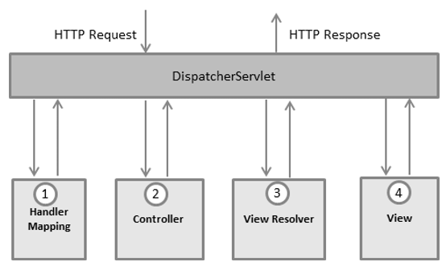
The DispatcherServlet
The Spring Web model-view-controller (MVC) framework is designed around a DispatcherServlet that handles all the HTTP requests and responses. The request processing workflow of the Spring Web MVC DispatcherServlet is illustrated in the following diagram

Slide 11
THANKS

